Slide 1
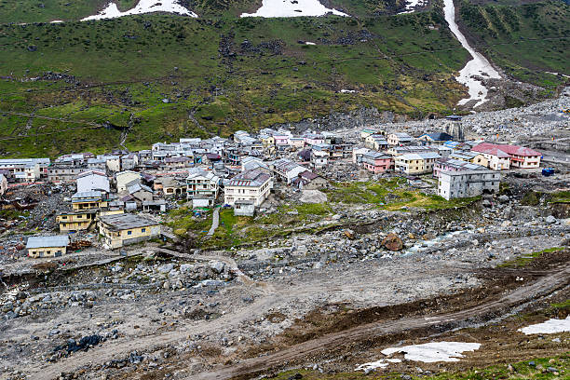

Slide 2
1

Slide 3
D
C
B
E
A
Five
Real-time monitoring for authorities
Scalable for floods, landslides, earthquakes
Improved coordination & rescue efficiency
Timely disaster alerts
Safe routes & shelters displayed
Expected Outcomes

Slide 4




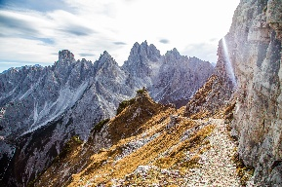
Expected Outcomes
A
B
C
D
E
Five
Timely disaster alerts
Real-time monitoring for authorities
Safe routes & shelters displayed
Improved coordination & rescue efficiency
Scalable for floods, landslides, earthquakes
Early warnings reach communities before flood escalation, enabling proactive response.
Authorities track flood progression instantly through centralized dashboard.
Interactive maps guide citizens to nearest safe locations during emergencies.
Enhanced communication between rescue teams, officials, and affected populations.
Adaptable system extends beyond floods—applicable to landslides, earthquakes, and other disasters.
Expected Outcomes

Slide 5






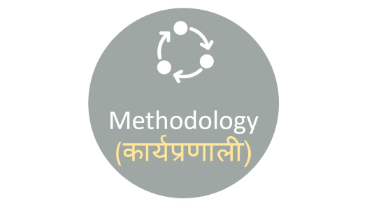


ASPECTS

Slide 6

Abstract(सारांश)

Slide 7

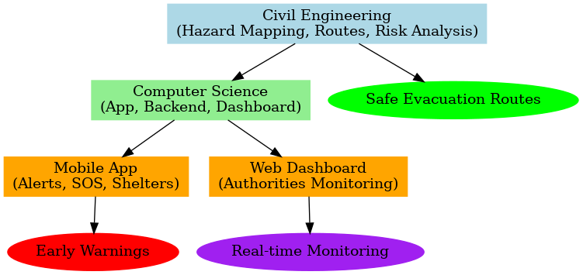
Abstract(सारांश)
The Smart Disaster Management System (SDMS) is a collaborative project by Civil and Computer Science departments, developed for disaster-prone regions of Uttarakhand. The civil part focuses on building a realistic terrain model with flood barriers, drainage channels, retaining walls, and water flow paths to demonstrate disaster control. The computer science part includes a smart website built using HTML, CSS, JavaScript, and Leaflet.js, which displays real-time alerts, SOS support, maps, and reporting systems. The project connects IoT sensors and Node.js–MongoDB for data handling. Together, both fields create a system that helps monitor, alert, and rescue effectively during disasters.

Slide 8

Key Points

Slide 9

Key Points
Goals
Save lives & reduce damage.
Manage flood levels in real-time
Cost-effective, scalable, and easy to maintain
Four-step barrier nets trap debris and reduce water speed
Water level sensors for early detection
Real-time Monitoring
Track floods & alerts instantly,
Alarm system for immediate warning
Web Dashboard
Easy access for everyone.
Safe Shelters & Routes
Maps for evacuation.

Slide 10

Methodology (कार्यप्रणाली)

Slide 11

Methodology (कार्यप्रणाली)
Design Database → Store & manage data (CS)
Create Web Dashboard → For monitoring & admin use (CS)
Integrate Alert System → SMS & notifications (Joint)
Test & Validate → Run simulations (Joint)
Collect Data → Rainfall, flood-prone areas, maps (Civil)
Map Safe Shelters & Routes → Evacuation planning (Civil)

Slide 12

Conclusion

Slide 13

Conclusion
In the end, our Smart Disaster Management System is not just a project — it’s a small step towards making Uttarakhand safer and more prepared for natural disasters.हमने इस प्रोजेक्ट में technology और civil design दोनों को मिलाया है ताकि लोगों तक सही जानकारी और मदद समय पर पहुँच सके।Through our website, people can get real-time alerts, SOS support, maps, and can also report incidents easily. The physical model shows how barriers, drainage, and proper planning can reduce the impact of floods and landslides.

Slide 14
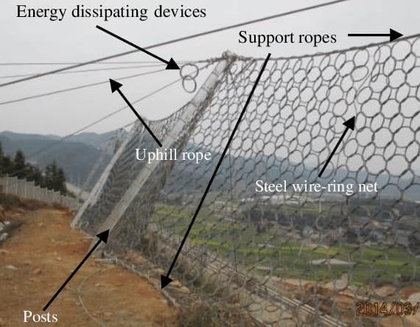
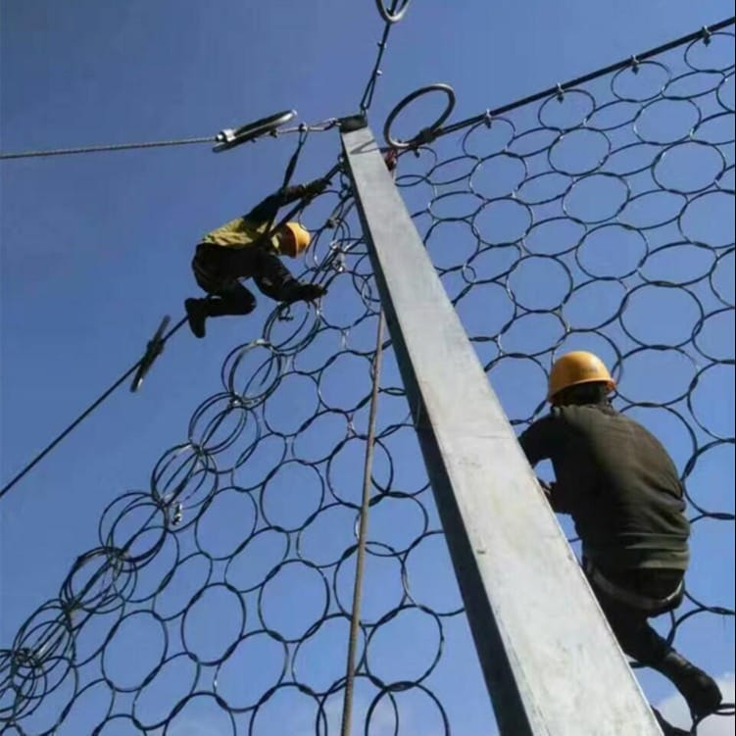
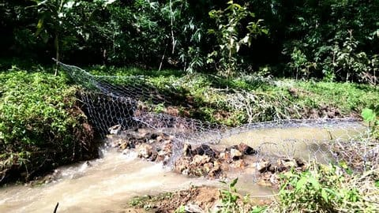

Slide 15
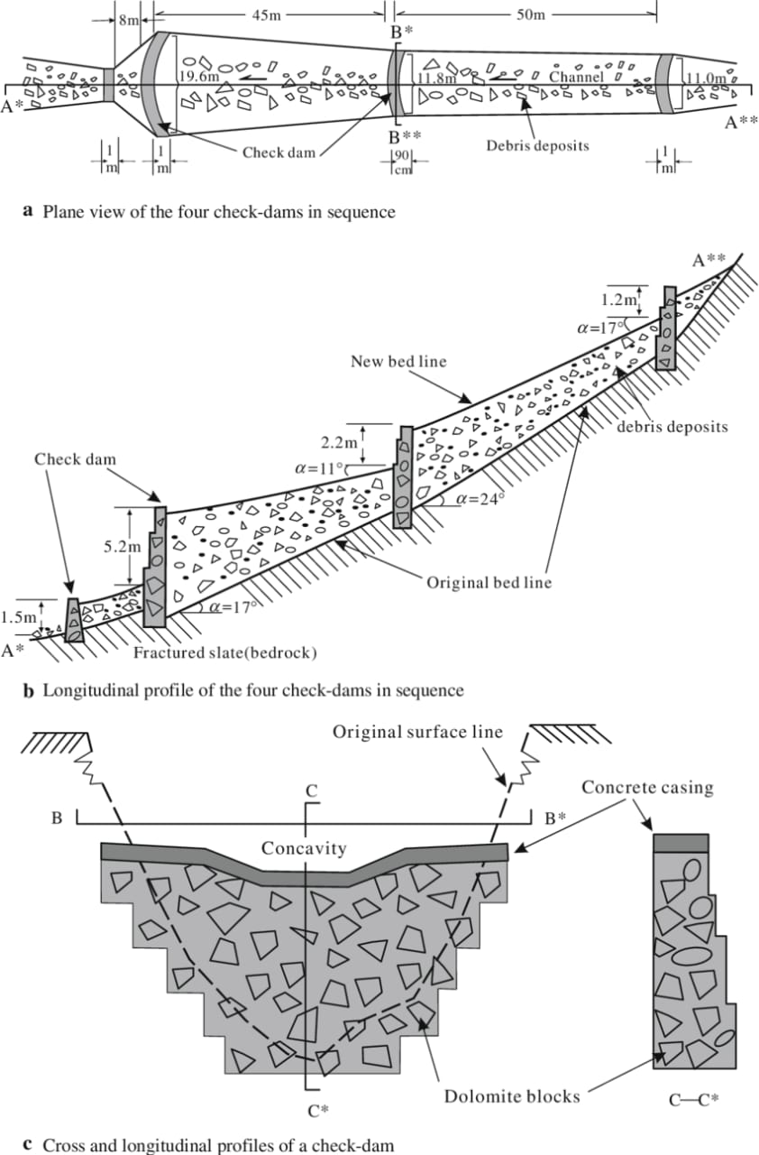
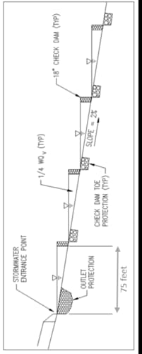

Slide 16
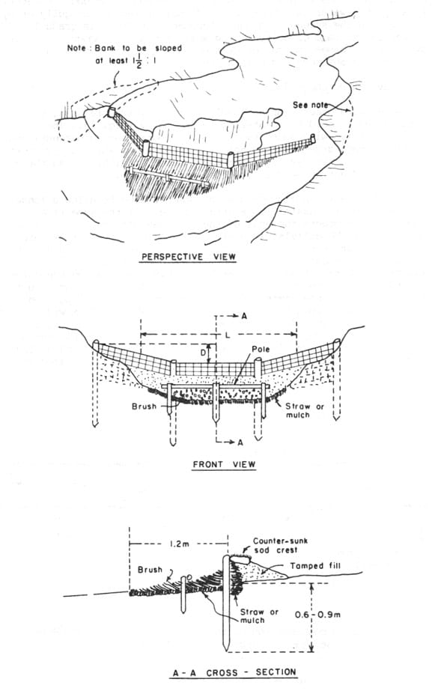
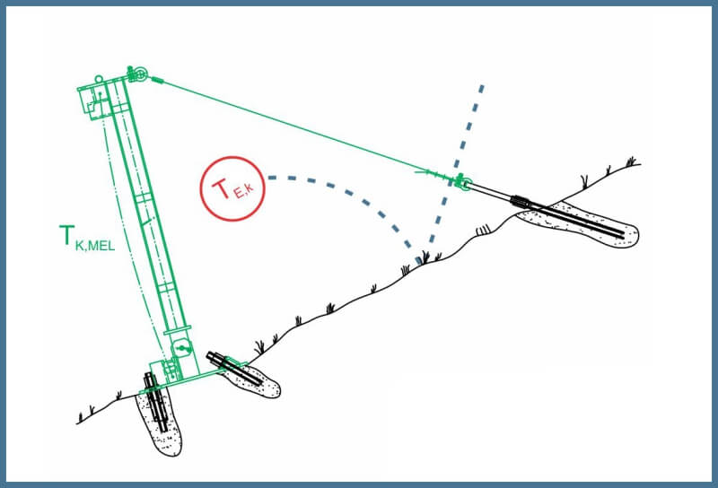

Slide 17
